Slide 1
Functional Design Patterns for OO Practitioners

Slide 2
Introduction
Our mission
We believe that:
We should care about functional programming. It is (a part of) the future.
Functional concepts are complementary to OO.
We’ve been thinking about:
What is the gist of functional programming?
Which functional concepts are helpful in an «object-functional» world?

Slide 3
Introduction
Disclaimer
We like to discuss these topics, but there’s not enough time for it today:
OO vs. FP: Which is better?
Java vs. Scala vs. Haskell vs. …: Which is better?
How to make our code even shorter
“pure” FP
The maths behind FP

Slide 4
Introduction
Functional programming in a nutshell
First-class and higher-order functions
Pure functions
Immutability
Lazy evaluation

Slide 5
Introduction
Functional programming in a nutshell
First-class and higher-order functions
Functions are objects, too
Passing functions as arguments to other functions
Examples: List.map/filter/fold
Pure functions
Immutability
Lazy evaluation

Slide 6
Introduction
Functional programming in a nutshell
First-class and higher-order functions
Pure functions
No side-effects
Functions are just transforming parameter values to return values
Referential transparency
Immutability
Lazy evaluation

Slide 7
Introduction
Functional programming in a nutshell
First-class and higher-order functions
Pure functions
Immutability
Data structures cannot be modified after instantiation
Lots of short-lived objects
Lazy evaluation

Slide 8
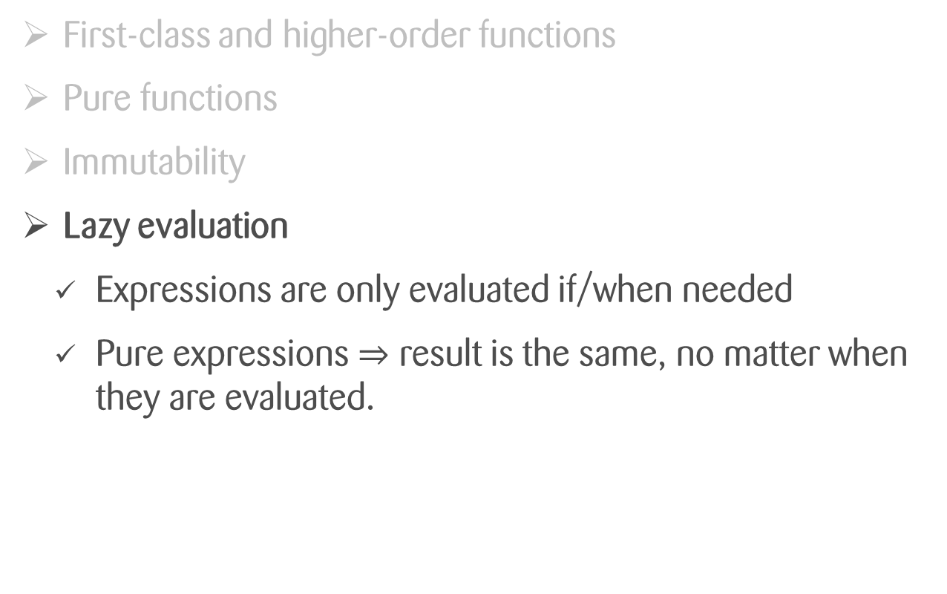
Introduction
Functional programming in a nutshell
First-class and higher-order functions
Pure functions
Immutability
Lazy evaluation
Expressions are only evaluated if/when needed
Pure expressions $⇒$ result is the same, no matter when they are evaluated.
Exceptions?
Termination?

Slide 9
Introduction
Functional Programming in 1 slide
It’s all about
transforming values
reducing side effects
Functional programming concepts focus on
expressing and composing value transformations
encapsulating side effect

Slide 10
Introduction
Functional patterns
There is no «Gang of 4» in functional programming.
«Functional patterns» is a less concise term.
Focus on composition of functions rather than composition of objects
More like guidelines, ideas, recipes

Slide 11
Introduction
Syntax used in this presentation
=> Scala in 30 seconds

Slide 12
Higher-Order Functions
Passing functions as arguments to other functions
Injecting code of lower level of abstraction into code of higher level of abstraction
In OO: Like implementing a template method or passing a callback object
Doesn’t this inevitably lead to a mess? What about callback hell?
Use side-effect free functions
Use well-known, generic higher-order functions

Slide 13
Higher-Order Functions
The most useful ones
map ^{Scala, Java, Haskell} / collect ^{Groovy}:
List(1,2,3).map(x => f(x)) == List(f(1), f(2), f(3))
filter/findAll
List(1,2,3).filter(x => x > 1) == List(2,3)
fold ^{Scala, Java, Haskell}/reduce ^{Groovy}
List(1,2,3).fold(zero, (acc, x) => f(acc, x)) == f(f(f(zero,1), 2), 3)
flatMap ^{Scala, Java} / bind ^{Haskell} / collectMany ^{Groovy}:
List(10,20,30).flatMap(x => List(x+1,x+2)) == List(11,12,21,22,31,32)

Slide 14
Higher-Order Functions
Example Application
Shopping Cart Total
Load cart items
Get prices of each item (map)
Compute the sum (fold/reduce)

Slide 15
Higher-Order Functions
Example Application
Suggestions
Load items similar to shopping cart items
Remove items with lower rating (filter)
Combine results (flatMap)

Slide 16
Higher-Order Functions
Lessons Learned
Code using these standard higher-order functions is
more declarative, less imperative, thus reveals its intention well
easy to read and understand, since behavior is well-defined
So far, so good
Not everything in the world is a List
But these concepts are applicable to a wider range of constructs

Slide 17
Higher-Order Functions
Container Types
Wrap another type and
add some functionality related to the wrapped type
provide a context for some value(s)
Examples
List[T]: combines multiple values of the wrapped type
Option[T]: represents a “collection” of 0 or 1 value
Future[T]: provides asynchronous computation of a value
Try[T]: represents the computation of a value, either successful or failed

Slide 18
The Option/Optional/Maybe Type
Collection of 0 or 1 value
Used instead of null
def loadUser(name: String): Option[User]
val john = loadUser(“John”)
> john: Option[User] = Some(User(1, “John”)
val elvis = loadUser(“Elvis”)
> elvis: Option[User] = None
Option
User

Slide 19
The Option/Optional/Maybe Type
Option
Option.map
User
val john = loadUser("John")
john.map(user => user.id)
> res0: Option[Int] = Some(1)
val elvis = loadUser("Elvis")
elvis.map(user => user.id)
> res0: Option[Int] = None
User
Int
map
Option
Int

Slide 20
The Option/Optional/Maybe Type
Option
Option.flatMap
User
def loadOrder(userId: Int): Option[Order]
val john = loadUser("John")
john.map(user => loadOrder(user.id)
val elvis = loadUser("Elvis")
elvis.map(user => loadOrder(user.id))
User
Order
flatMap
Option
Order

Slide 21
The Try Type
Represents the computation of a value, either successful or failed
Used instead of throwing exceptions
def loadUser(id: Int): Try[User]
loadUser(1)
> res0: Try[User] = Success(User(1, “John”))
loadUser(1000)
> res1: Try[User] = Failure(Exception(«user does not exist»))
Try
User

Slide 22
Composable Future
Future
User

Slide 23
Higher-Order Functions
Lessons learned
Don’t leave the box (too early)!
Good language support for Option/Optional/Maybe
Try is less widely supported
Composable Future still missing in Java

Slide 24
Outcomes
How to avoid side effects, how to write pure code
Immutability
A basic set of higher-order functions is enough to build most of what you need. Everything else is built by composition
Not everything we showed is possible in Java/other OO languages. Sometimes it’s possible to emulate it, sometimes there are libraries that do this

